Slide 1
Code Analyzer
Trevor Jazynka, Zekun Li, Cooper Robson, Ben Fielder

Slide 2
Problem Statement
Software engineers spend a lot of time understanding team members code
Adding onto existing code can be very difficult and time consuming
The current software engineering processes tries to mitigate these problems through team meetings, code reviews and constant communication

Slide 3
Proposed Solution
An algorithm that decides each team member’s coding style by analyzing code files
A database that categorizes every code file to the corresponding team member
An A.I. that analyzes code from the best programming practices and is in the background while you code to give you ideas and to show you similar ways that may be quicker to use.
A pairing system that matches team members with similar coding styles
Notes:
We feel the combination of these two tools will reach both senior and junior software engineers.This will increase the time spent coding for software engineers by at least 10-20%.

Slide 4
Related Work
Similar Products
OpenAI Codex
SonarQube
Papers
Today was a Good Day: The Daily Life of Software Developers
32% of a software engineer's day at Microsoft was spent actually coding
There was a sample size of 5,000 employees

Slide 5
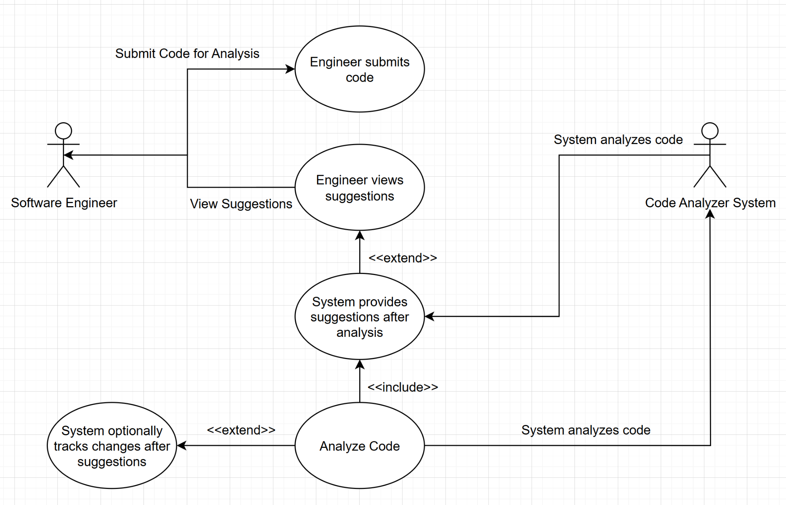
Use Case Diagram 1: Code Analysis and Suggestion

Slide 6
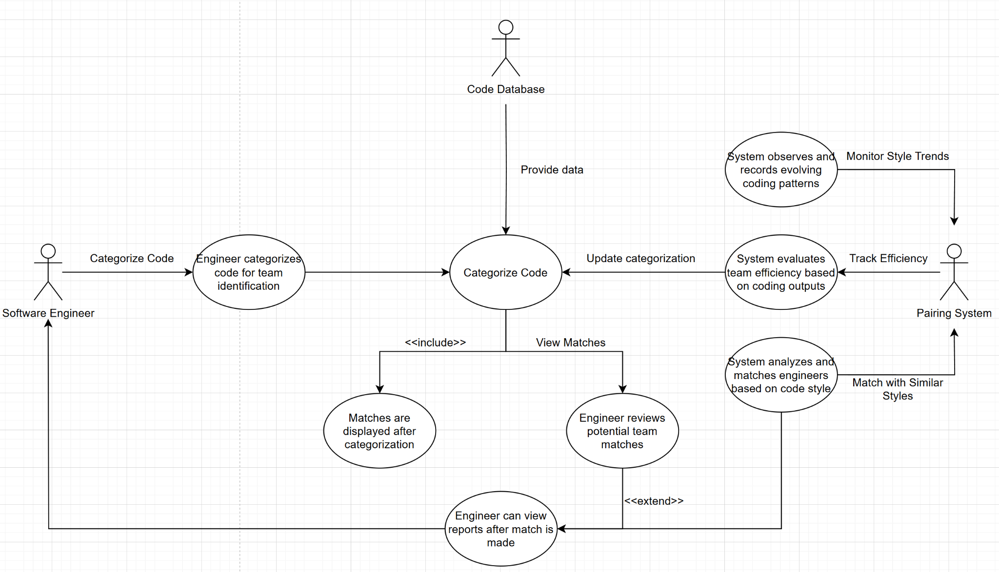
Use Case Diagram 2: Member Categorization and Matching

Slide 7
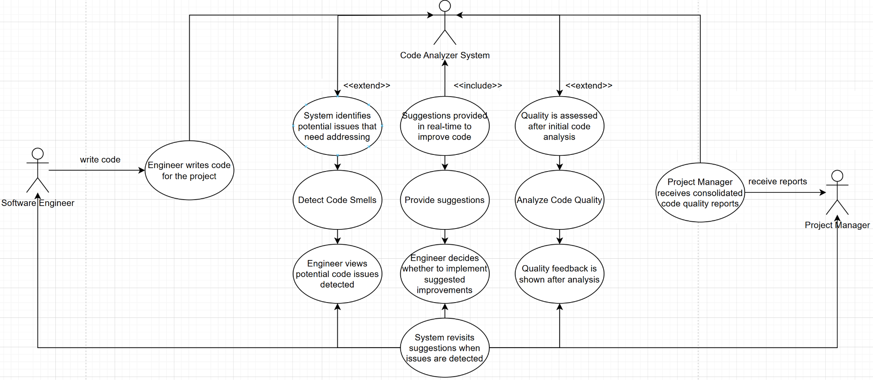
Use Case Diagram 3: Code Assistance and Feedback

Slide 8
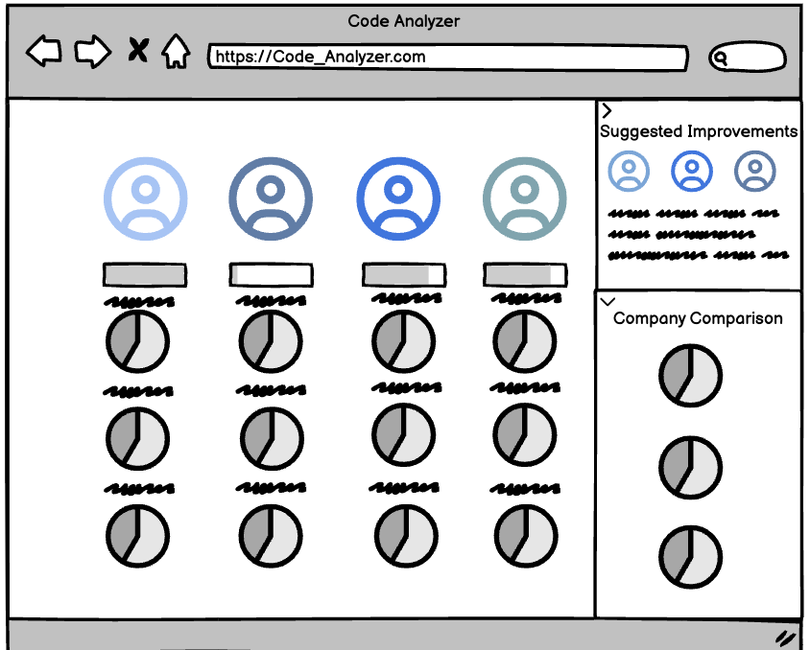
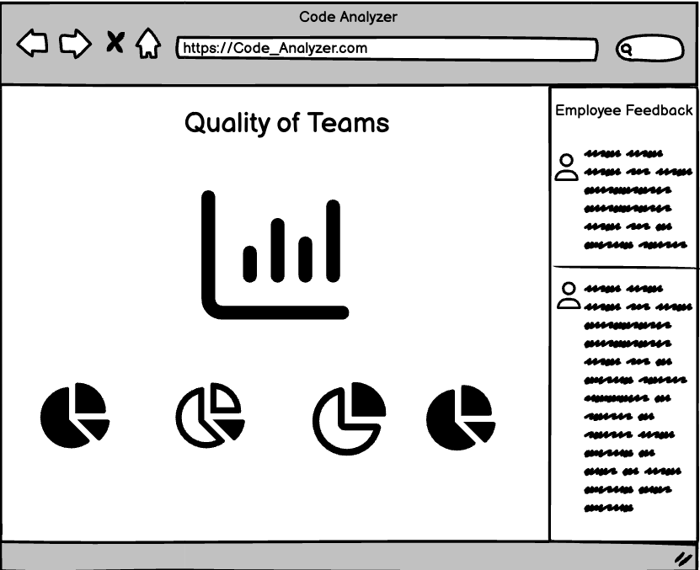
Visual Representation - Wireframe

Slide 9
Limitations and Future Work
New Features
Expand for all coders for a smoother hiring process
AI code assistant integration
Limitations
Marketing capital to get this tool widely adapted
AI is not at the point for seamless integration of coding tasks

Slide 10
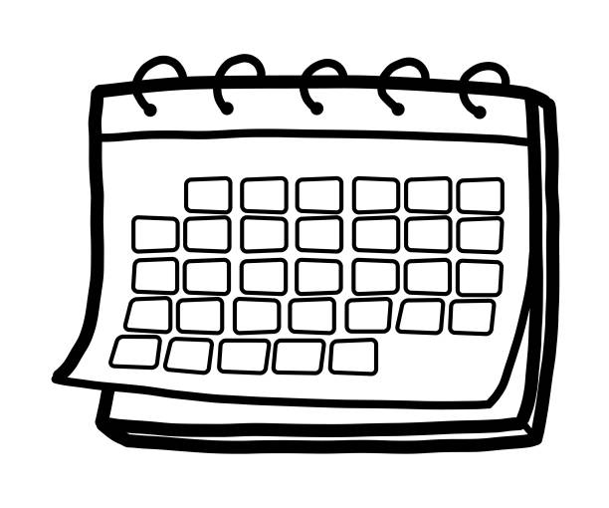
Processes and Tools Used
End of Sprint Retrospectives
Have allowed us to address issues, reevaluate priorities, and optimize work distribution
Requirements Elicitation
The requirement elicitation we chose to use (survey) gave us valuable information about the pros and cons of our idea, as well as ways we could implement it to be most effective
High Level Architectural Design
Helped us specify functional and non-functional requirements for our system.
We chose MVC Architecture, which would help optimize reuse of specific parts and the flow of information between the user, the algorithm, and the display.

Slide 11

Things We Learned
There are many ways to design and implement a product, optimization is crucial!
Solutions can be optimized through the type of software process used, method of requirement elicitation, type of high and low level design, and more.
Effective project management involves more than just delivering a product as fast as you can.
Optimizing the people, product, process and project are vital for a solution to be valid.
There are many constraints when considering a solution to a problem
Some constraints include: requirements, scope, time, budget, manpower, etc.
Just because a solution meets on constraint, doesn’t mean it is the best solution

Slide 12
Questions?

